Slide 1
Conceptual Physics Fundamentals
HEAT TRANSFER AND
CHANGE OF PHASE

Slide 2
This lecture will help you understand:
Conduction
Convection
Radiation
Newton’s Law of Cooling
Global Warming and the Greenhouse Effect
Heat Transfer and Change of Phase
Solar Power
Controlling Heat Transfer

Slide 3
Heat Transfer and Change of Phase
Objects in thermal contact at different temperatures tend to reach a common temperature in three ways:
  conduction
  convection
  radiation

Slide 4
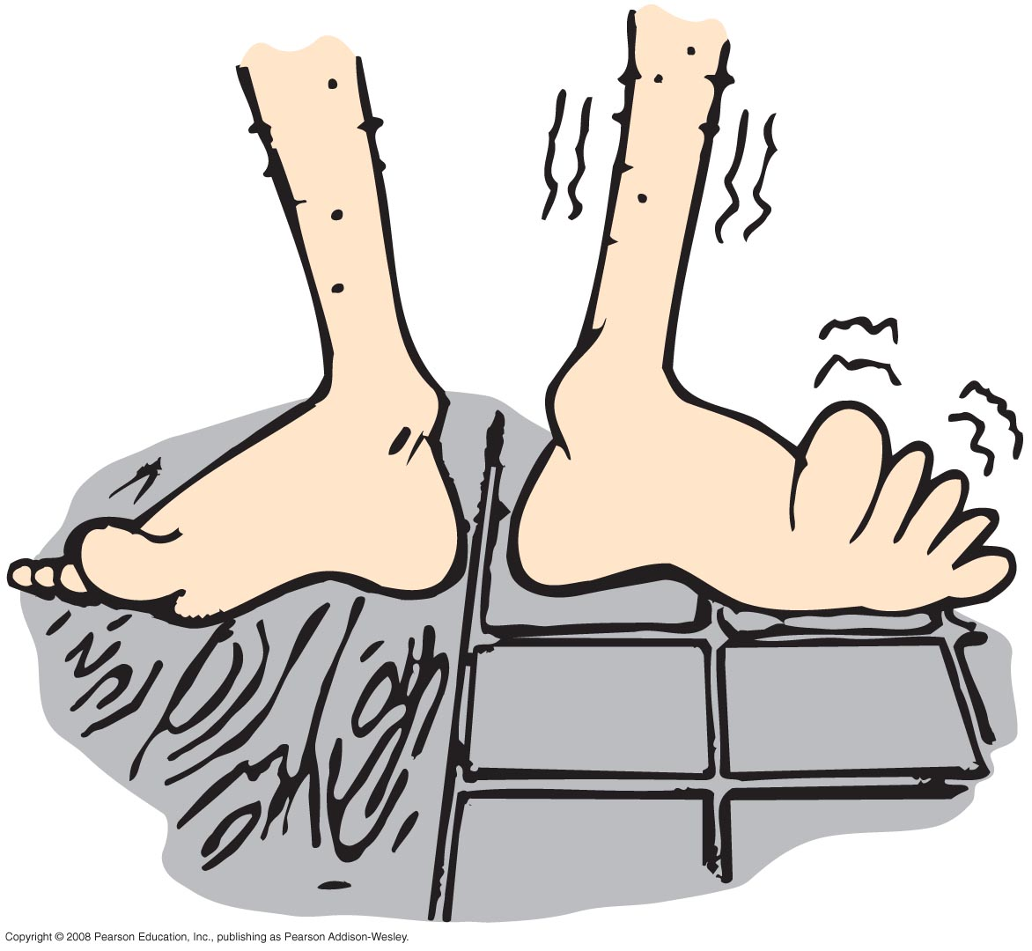
Conduction
Conduction
transfer of internal energy by electron and molecular collisions within a substance, especially a solid

Slide 5
Conduction
Conductors
good conductors conduct heat quickly
  substances with loosely held electrons transfer energy quickly to other electrons throughout the solid
  example: silver, copper, and other solid metals

Slide 6
Conduction
Conductors (continued)
poor conductors are insulators
  molecules with tightly held electrons in a substance vibrate in place and transfer energy slowly—these are good insulators (and poor conductors)
example: glass, wool, wood, paper, cork, plastic foam, air
substances that trap air are good insulators
example: wool, fur, feathers, and snow

Slide 7
If you hold one end of a metal bar against a piece of ice, the end in your hand will soon become cold. Does cold flow from the ice to your hand?
Conduction
CHECK YOUR NEIGHBOR
A. yes
in some cases, yes
no
in some cases, no
Notes:
C. No.

Slide 8
If you hold one end of a metal bar against a piece of ice, the end in your hand will soon become cold. Does cold flow from the ice to your hand?
Conduction
CHECK YOUR ANSWER
A. yes
in some cases, yes
no
in some cases, no
Explanation:
Cold does not flow from the ice to your hand. Heat flows from your hand to the ice. The metal is cold to your touch, because you are transferring heat to the metal.
Notes:
C. No.

Slide 9
Conduction
Insulation
doesn’t prevent the flow of internal energy
slows the rate at which internal energy flows
example: rock wool or fiberglass between walls slows the transfer of internal energy from a warm house to a cool exterior in winter, and the reverse in summer

Slide 10
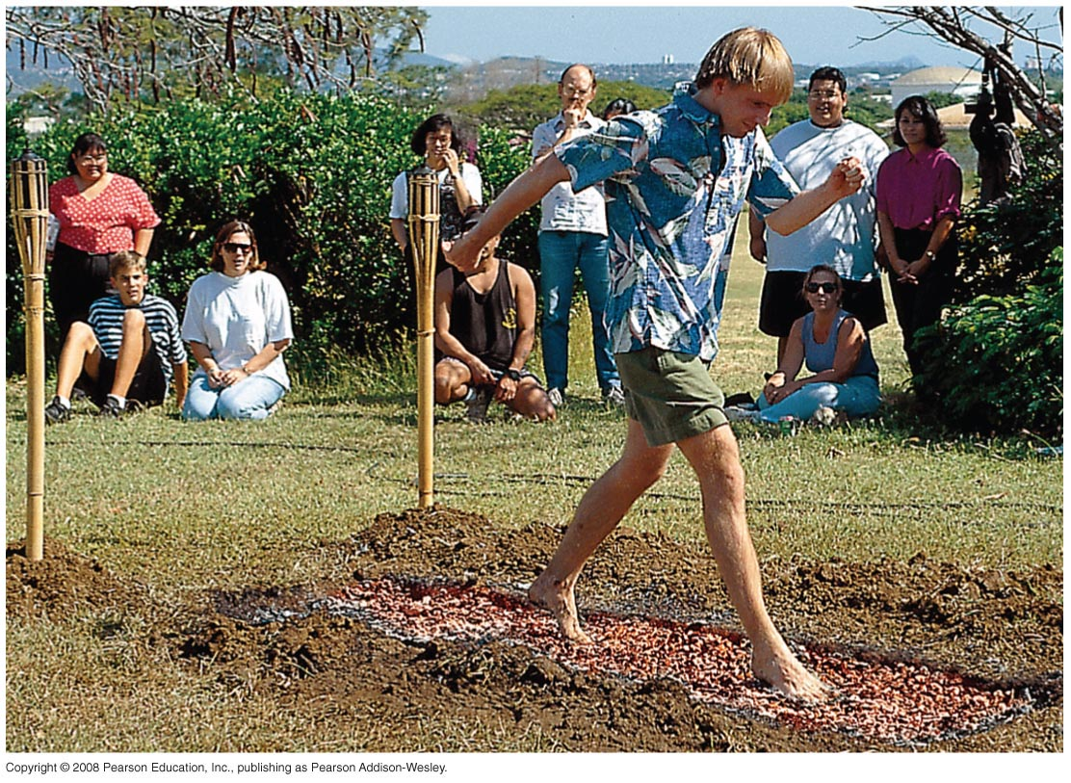
Conduction
Insulation (continued)
dramatic example: walking barefoot without burning feet on red-hot coals is due to poor conduction between coals and feet

Slide 11
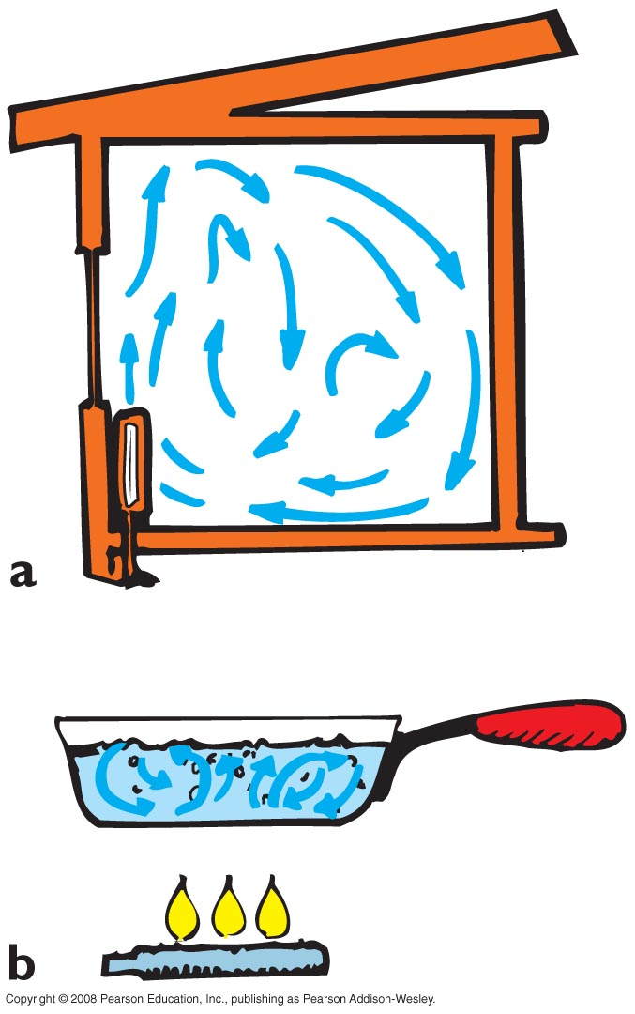
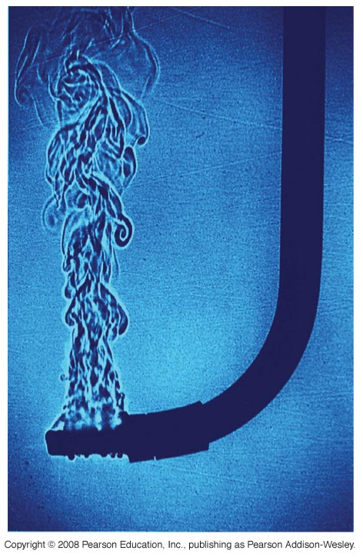
Convection
Convection
transfer of heat involving only bulk motion of fluids
example:
  visible shimmer of air above a hot stove or above asphalt on a hot day
  visible shimmers in water due to temperature difference

Slide 12
Convection
Reason warm air rises
warm air expands, becomes less dense, and is buoyed upward
it rises until its density equals that of the surrounding air
example: smoke from a fire rises and blends with the surrounding cool air

Slide 13
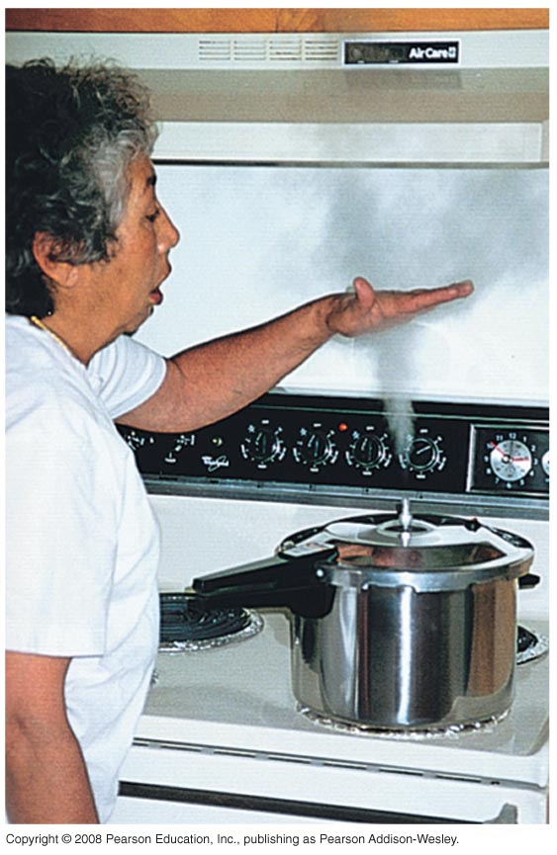
Convection
Cooling by expansion
opposite to the warming that occurs when air is compressed
example: the “cloudy” region above hot steam issuing from the nozzle of a pressure cooker is cool to the touch (a combination of air expansion and mixing with cooler surrounding air)
Careful, the part at the nozzle that you can’t see is steam—ouch!

Slide 14
Although warm air rises, why are mountaintops cold and snow covered, while the valleys below are relatively warm and green?
Convection
CHECK YOUR NEIGHBOR
A. Warm air cools when rising.
There is a thick insulating blanket of air above valleys.
both A and B
none of the above
Notes:
C. Both of the above.

Slide 15
Although warm air rises, why are mountaintops cold and snow covered, while the valleys below are relatively warm and green?
Convection
CHECK YOUR ANSWER
A. Warm air cools when rising.
There is a thick insulating blanket of air above valleys.
both A and B
none of the above
Explanation:
Earth’s atmosphere acts as a blanket, which keeps the valleys from freezing at nighttime.
Notes:
C. Both of the above.

Slide 16
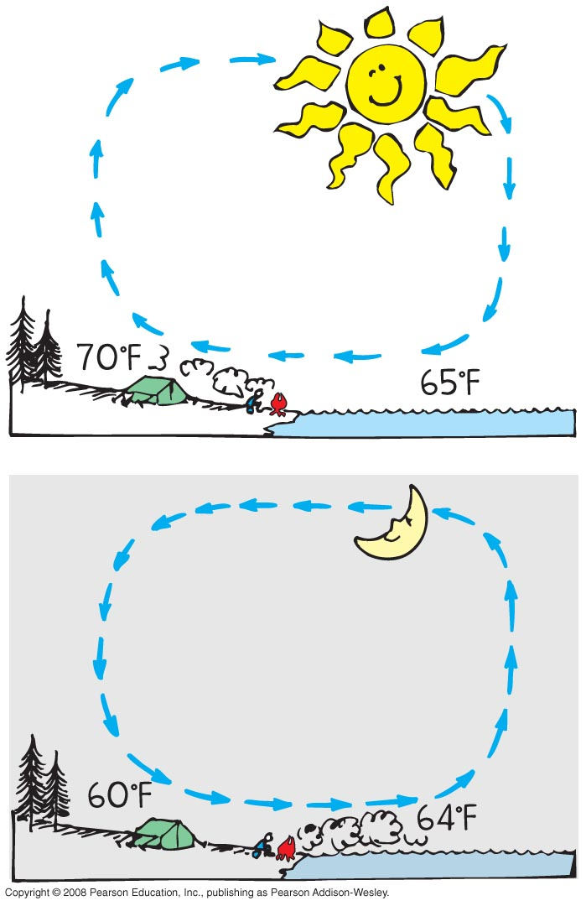
Convection
Winds
result of uneven heating of the air near the ground
  absorption of Sun’s energy occurs
  more readily on different parts of
  Earth’s surface
sea breeze
  The ground warms more than water
  in the daytime.
  Warm air close to the ground rises
  and is replaced by cooler air from
  above the water.

Slide 17
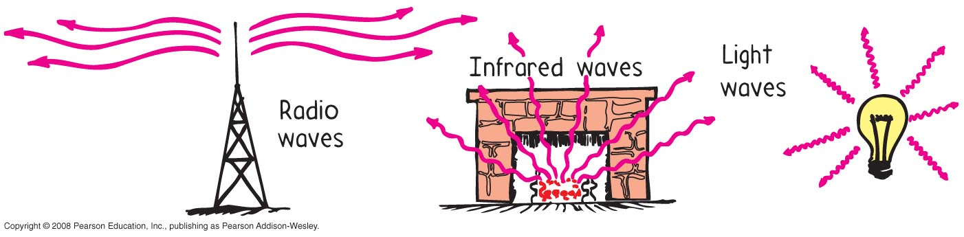
Radiation
Radiation
transfer of energy from the Sun through empty space

Slide 18
The surface of Earth loses energy to outer space due mostly to
Radiation
CHECK YOUR NEIGHBOR
A. conduction.
convection.
radiation.
radioactivity.
Notes:
C. radiation.

Slide 19
The surface of Earth loses energy to outer space due mostly to
Radiation
CHECK YOUR ANSWER
A. conduction.
convection.
radiation.
radioactivity.
Explanation:
Radiation is the only choice, given the vacuum of outer space.
Notes:
C. radiation.

Slide 20
Which body glows with electromagnetic waves?
Radiation
CHECK YOUR NEIGHBOR
A. Sun
Earth
both A and B
neither A nor B
Notes:
C. Both.

Slide 21
Which body glows with electromagnetic waves?
Radiation
CHECK YOUR ANSWER
A. Sun
Earth
both A and B
neither A nor B
Explanation:
Earth glows in long-wavelength radiation, while the Sun glows in shorter waves.
Notes:
C. Both.

Slide 22
Radiation
Radiant energy
transferred energy
exists as electromagnetic waves ranging from long (radio waves) to short wavelengths (X-rays)
in visible region, ranges from long waves (red) to short waves (violet)

Slide 23
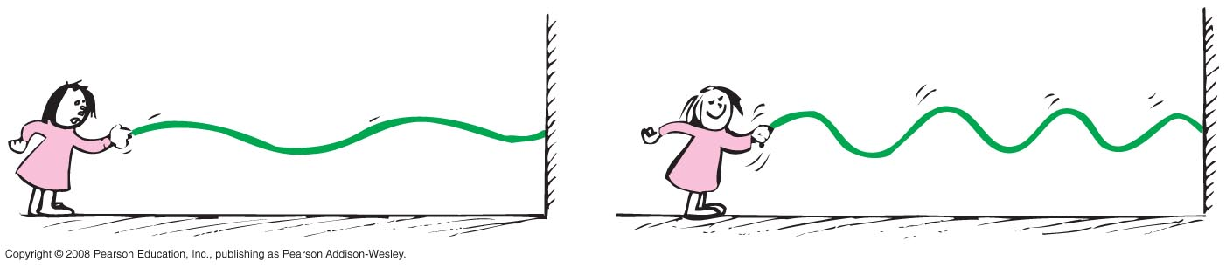
Radiation
Wavelength of radiation
related to frequency of vibration (rate of vibration of a wave source)
  low frequency vibration produces long-wavelength waves
  high frequency vibration produces short-wavelength waves

Slide 24
Radiation
Emission of radiant energy
every object above absolute zero radiates
from the Sun’s surface comes light, called electromagnetic radiation, or solar radiation
from the Earth’s surface is terrestrial radiation in the form of infrared waves below our threshold of sight

Slide 25

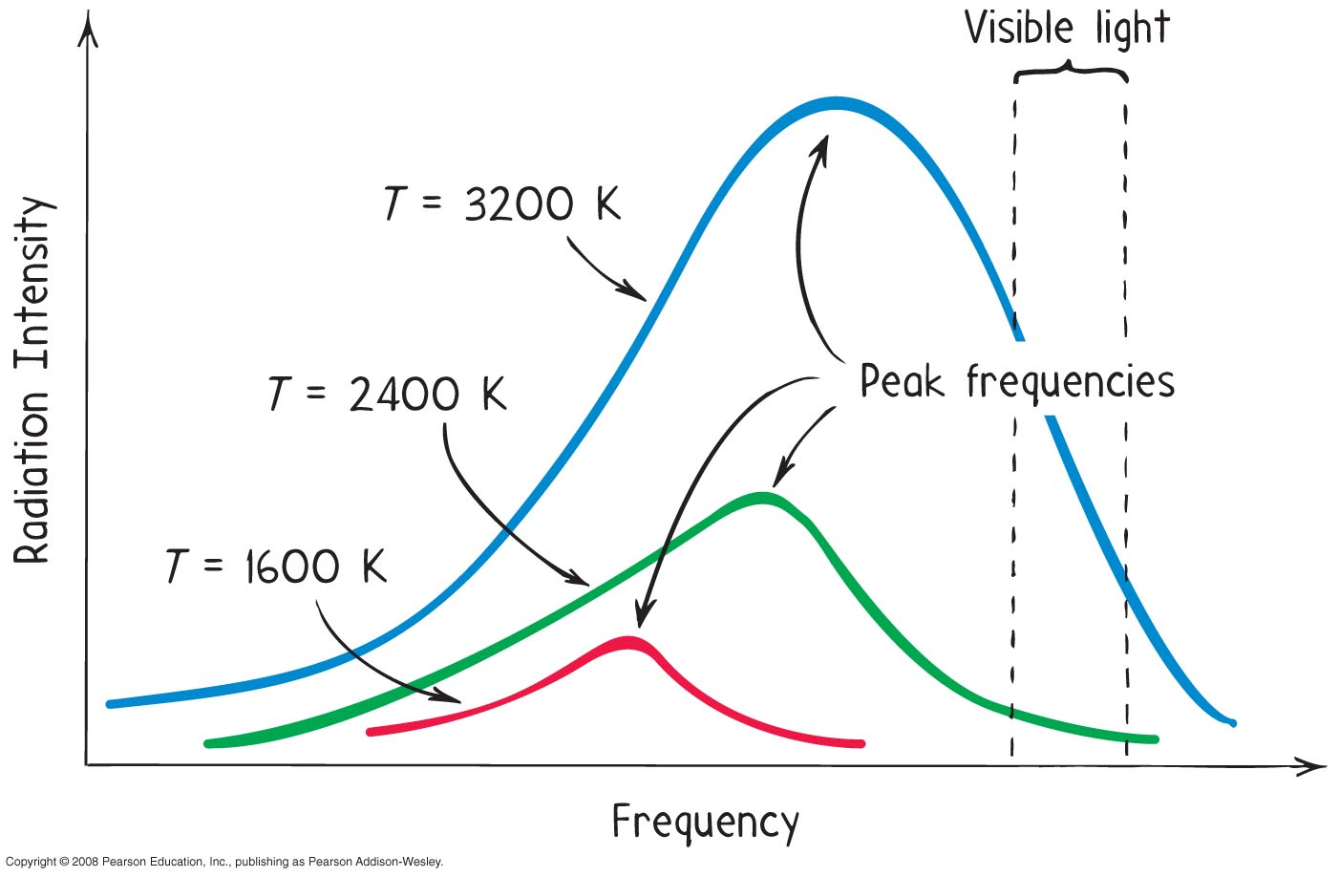
Radiation
Emission of radiant energy (continued)
frequency of radiation is proportional to the absolute temperature of the source ( )

Slide 26
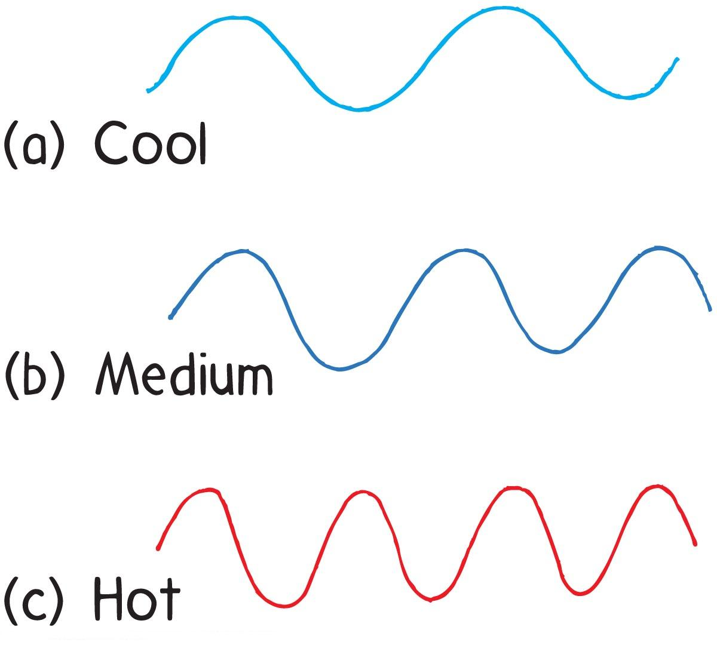
Radiation
Range of temperatures of radiating objects
room temperature emission is in the infrared
temperature above 500°C,
red light emitted, longest
waves visible
about 600°C, yellow light
emitted
at 1500°C, object emits
white light (whole range
of visible light)

Slide 27
Radiation
Absorption of radiant energy
occurs along with emission of radiant energy
effects of surface of material on radiant energy
  any material that absorbs more than it emits is a net absorber
  any material that emits more than it absorbs is a net emitter
  net absorption or emission is relative to temperature of surroundings

Slide 28
Radiation
Absorption of radiant energy (continued)
occurs along with emission of radiant energy
  good absorbers are good emitters
  poor absorbers are poor emitters
  example: radio dish antenna that is a good emitter is also a good receiver (by design, a poor transmitter is a poor absorber)

Slide 29
If a good absorber of radiant energy were a poor emitter, its temperature compared with its surroundings would be
Radiation
CHECK YOUR NEIGHBOR
A. lower.
higher.
unaffected.
none of the above
Notes:
B. higher.

Slide 30
If a good absorber of radiant energy were a poor emitter, its temperature compared with its surroundings would be
Radiation
CHECK YOUR ANSWER
A. lower.
higher.
unaffected.
none of the above
Explanation:
If a good absorber were not also a good emitter, there would be a net absorption of radiant energy, and the temperature of a good absorber would remain higher than the temperature of the surroundings. Nature is not so!
Notes:
B. higher.

Slide 31
A hot pizza placed in the snow is a net
Radiation
CHECK YOUR NEIGHBOR
A. absorber.
emitter.
both A and B
none of the above
Notes:
B. emitter.

Slide 32

A hot pizza placed in the snow is a net
Radiation
CHECK YOUR ANSWER
A. absorber.
emitter.
both A and B
none of the above
Explanation:
The relation tells us that high temperature sources emit high frequency waves. High frequency waves have short wavelength.
Notes:
B. emitter.

Slide 33
Which melts faster in sunshine—dirty snow or clean snow?
Radiation
CHECK YOUR NEIGHBOR
A. dirty snow
clean snow
both A and B
none of the above
Notes:
A. Dirty snow.

Slide 34
Which melts faster in sunshine—dirty snow or clean snow?
Radiation
CHECK YOUR ANSWER
A. dirty snow
clean snow
both A and B
none of the above
Explanation:
Dirty snow absorbs more sunlight, whereas clean snow reflects more.
Notes:
A. Dirty snow.

Slide 35
Radiation
Reflection of radiant energy
opposite to absorption of radiant energy
any surface that reflects very little or no radiant energy looks dark
examples of dark objects:
  eye pupils
  open ends of pipes in a stack
  open doorways or windows of distant houses in the daytime

Slide 36
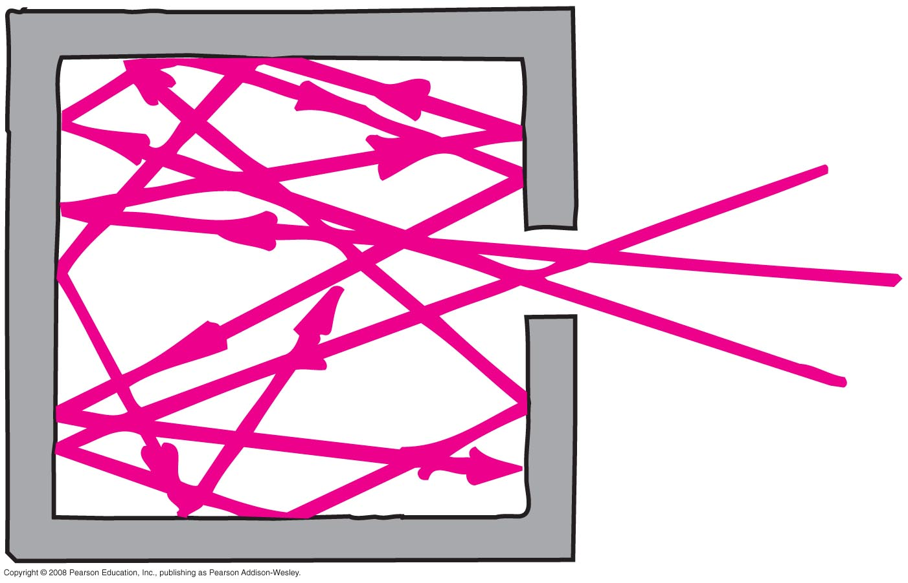
Radiation
Reflection of radiant energy (continued)
darkness often due to reflection of light back and forth many times partially absorbing with each reflection
good reflectors are poor absorbers

Slide 37
Which is the better statement?
Radiation
CHECK YOUR NEIGHBOR
A. A black object absorbs energy well.
An object that absorbs energy well is black.
Both say the same thing, so both are equivalent.
Both are untrue.
Notes:
B. An object that absorbs energy well is black.

Slide 38
Which is the better statement?
Radiation
CHECK YOUR ANSWER
A. A black object absorbs energy well.
An object that absorbs energy well is black.
Both say the same thing, so both are equivalent.
Both are untrue.
Explanation:
This is a cause-and-effect question. The color black doesn’t draw in and absorb energy. It’s the other way around—any object that does draw in and absorb energy, will, by consequence, be black in color.
Notes:
B. An object that absorbs energy well is black.

Slide 39
Newton’s Law of Cooling
Newton’s Law of Cooling
approximately proportional to the temperature difference ΔT between the object and its surroundings
in short: rate of cooling ~ ΔT
example:
  hot apple pie cools more each minute in a freezer than if left on the kitchen table
  warmer house leaks more internal energy to the outside than a house that is less warm

Slide 40
Newton’s Law of Cooling
Newton’s Law of Cooling (continued)
applies to rate of warming
  object cooler than its surroundings warms up at a rate proportional to ΔT
  example: frozen food will warm faster in a warm room than in a cold room

Slide 41
It is commonly thought that a can of beverage will cool faster in the coldest part of a refrigerator. Knowledge of Newton’s law of cooling
Newton’s Law of Cooling
CHECK YOUR NEIGHBOR
A. supports this knowledge.
shows this knowledge is false.
may or may not support this knowledge.
may or may not contradict this knowledge.
Notes:
A. supports this knowledge.

Slide 42
It is commonly thought that a can of beverage will cool faster in the coldest part of a refrigerator. Knowledge of Newton’s law of cooling
Newton’s Law of Cooling
CHECK YOUR ANSWER
A. supports this knowledge.
shows this knowledge is false.
may or may not support this knowledge.
may or may not contradict this knowledge.
Notes:
A. supports this knowledge.

Slide 43
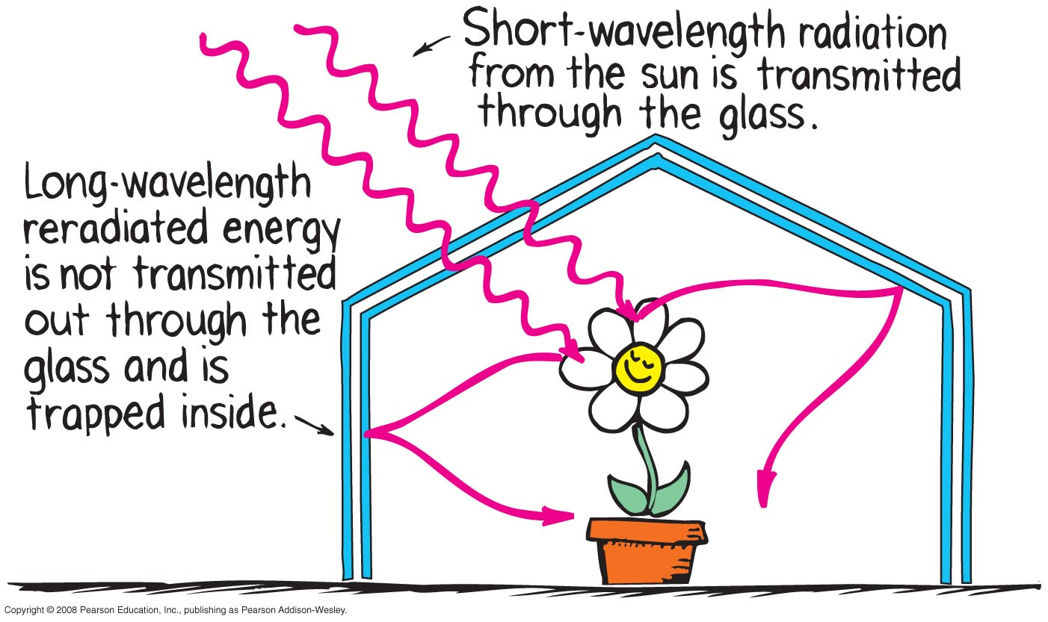
Global Warming and the Greenhouse Effect
Greenhouse effect
named for a similar temperature-raising effect in florists’ greenhouses

Slide 44
Global Warming and the Greenhouse Effect
understanding greenhouse effect requires two concepts:
  all things radiate at a frequency (and therefore wavelength) that depends on the temperature of the emitting object
  transparency of things depends on the wavelength of radiation

Slide 45
Global Warming and the Greenhouse Effect
understanding greenhouse effect requires two concepts (continued)
  example: Excessive warming of a car’s interior when windows are closed on a hot sunny day. Sun’s rays are very short and pass through the car’s windows. Absorption of Sun’s energy warms the car interior. Car interior radiates its own waves, which are longer and don’t transmit through the windows. Car’s radiated energy remains inside, making the car’s interior very warm.

Slide 46
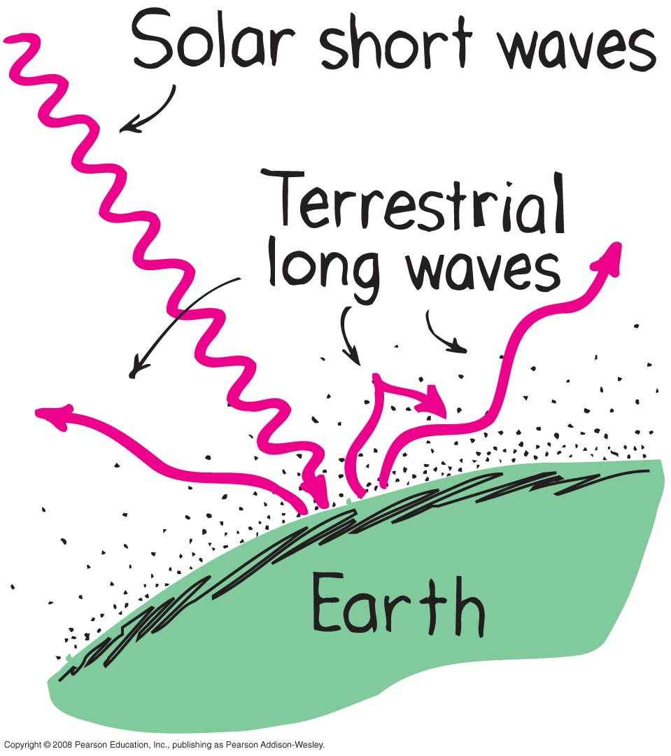
Global Warming and the Greenhouse Effect
Global warming
energy absorbed from the Sun
part reradiated by Earth as longer-wavelength terrestrial radiation

Slide 47
Global Warming and the Greenhouse Effect
Global warming (continued)
terrestrial radiation absorbed by atmospheric gases and re-emitted as long-wavelength terrestrial radiation back to Earth
reradiated energy unable to escape, so warming of Earth occurs
long-term effects on climate are of present concern

Slide 48
The “greenhouse gases” that contribute to global warming absorb
Global Warming and the Greenhouse Effect
CHECK YOUR NEIGHBOR
A. more visible radiation than infrared.
more infrared radiation than visible.
visible and infrared radiation about equally.
very little radiation of any kind.
Notes:
B. more infrared radiation than visible.

Slide 49
The “greenhouse gases” that contribute to global warming absorb
Global Warming and the Greenhouse Effect
CHECK YOUR ANSWER
A. more visible radiation than infrared.
more infrared radiation than visible.
visible and infrared radiation about equally.
very little radiation of any kind.
Explanation:
Choice A has the facts backward. Choices C and D are without merit.
Notes:
B. more infrared radiation than visible.

Slide 50
Solar Power
Solar power is what you have once solar energy has been converted to electricity.
Solar power can be generated using photovoltaic cells, or by changing water to steam to turn a generator

Slide 51
Solar Power
Why the Sun feels hot
The surface temperature of the Sun is about 6000ºC. Some welding torches can also be this hot. We are warmed by the Sun primarily because it is so big
Solar Constant
The earth receives about 1400 Joules of energy every second over a square meter (at right angles).
This is known as the solar constant (1.4 kW/m²)

Slide 52
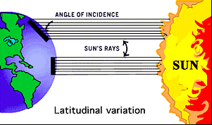
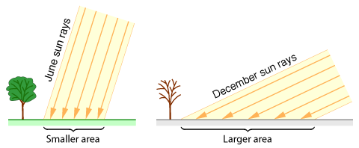
Angle of Sun
The intensity of sunlight striking the ground depends on the sun's angle in the sky. When the sun is at a lower angle, the same amount of energy is spread over a larger area of ground, so the ground is heated less. The angles shown here are for the noon sun at latitude 41° north.
This also explains why the north and south pole are so much colder than the equator

Slide 53
Controlling Heat transfer
Recall the three methods for heat transfer: conduction, convection and radiation
Consider a vacuum bottle (trademark Thermos)
A thermos is a double walled glass container with a vacuum between the walls and close fitting stopper
The glass walls that face each other are silvered (mirrored)

Slide 54
Controlling Heat transfer- Thermos
Conduction- heat conduction through a vacuum is impossible There may be some conduction heat loss around the stopper
Convection- convection requires liquid, heat transfer via convection is impossible in through the vacuum
Radiation- because the glass surfaces are silvered heat loss by radiation is greatly reduced
Liquids can stay hot (or cold) for hours in a vacuum bottle

